Slide 1


The Lunar Reconnaissance Orbiter
17th Annual
The University of Arizona
NASA Space Grant Symposium
Stephanie M. Craig
April 17th, 2010
Mentors:
Dr. Alfred S. McEwen
&
Mrs. Ingrid Daubar Spitale
Notes:
Reconnaissance: inspection or exploration of an area (The Free Encyclopedia)

Slide 2
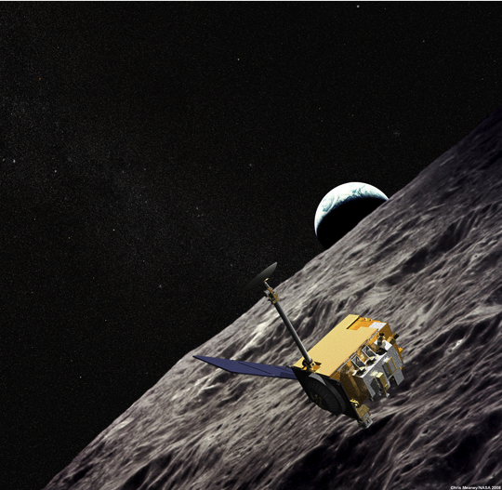

Introduction
On 23 June 2009, NASA launched a search for new lunar impacts to determine activity around the moon and to date the moon’s surface using technology aboard the Lunar Reconnaissance Orbiter (LRO).
Notes:
National Aeronautics and Space Administration

Slide 3
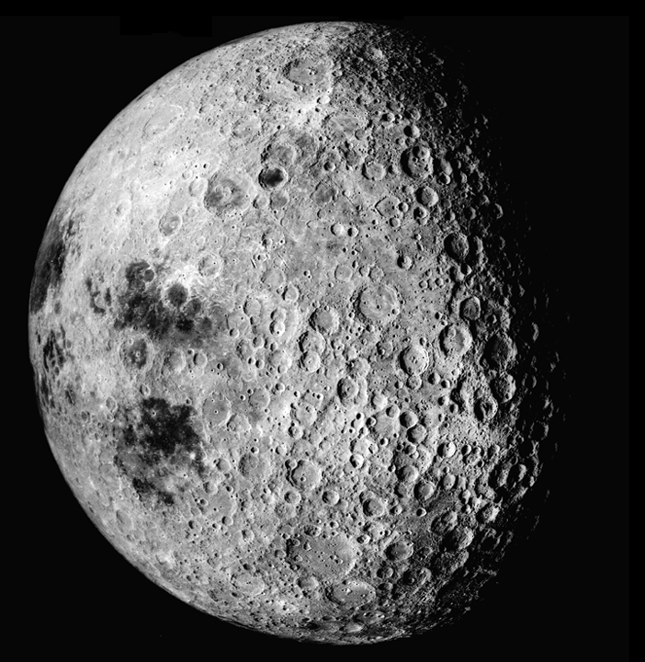
Presentation Objectives
1) Introduce LROC
2) Define my team’s role in the project
3) Present methods used
4) Outline the results
5) Interpret the findings

Slide 4

Project Objectives
Develop the best system for comparing images
Determine the number of small impacts since 1971-1972 in order to gauge the safety of future lunar surface operations and interplanetary travel.
Date the surface

Slide 5
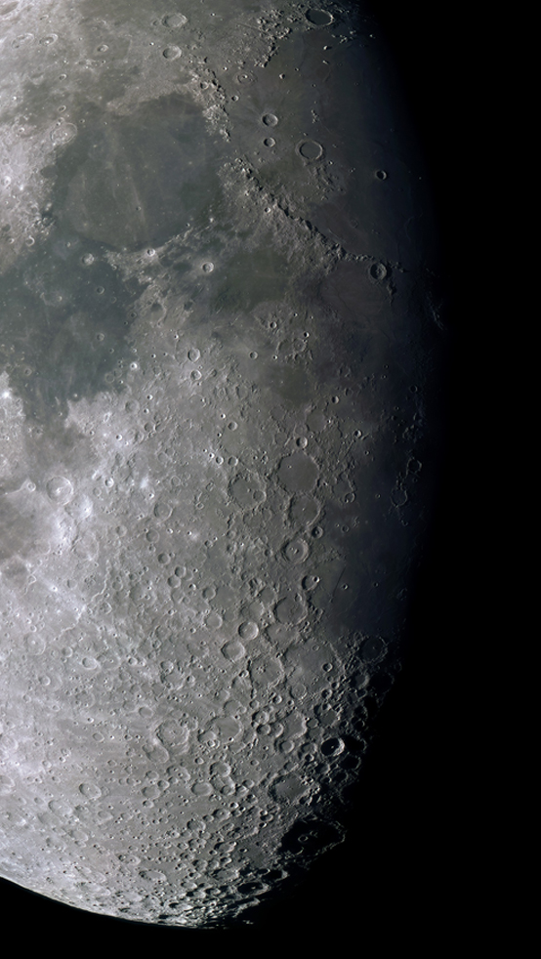

Hypothesized Results
Neukum’s production function gives:
  Blink
  compare
  the images
  at a rate of
  1 image / 10 min
  10 of these craters are
  needed to begin to get a
  decent size-frequency distribution
  1 / 638 Narrow Angle Camera (NAC)
  full-res. image returned should have a new crater
  25 new impact craters, 10 m diameter, form / year.
  (Alfred McEwen)
Notes:
Each NAC image (at 0.5 m/pixel) covers only 0.000165% of the Moon
Each image has ~10 good candidates per low-phase image, however these are up to ~240,000 years old

Slide 6
Methods & Techniques
Software utilized:
ISIS
Qview
ExpressView
Photoshop
Develop the system

Slide 7
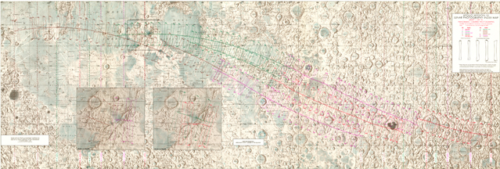
Apollo Panoramic
Image Map
Narrow Angle Camera (NAC) heads aboard the LRO Camera (LROC) returned high-resolution, black and white images overlapping Apollo panoramic images.

Slide 8
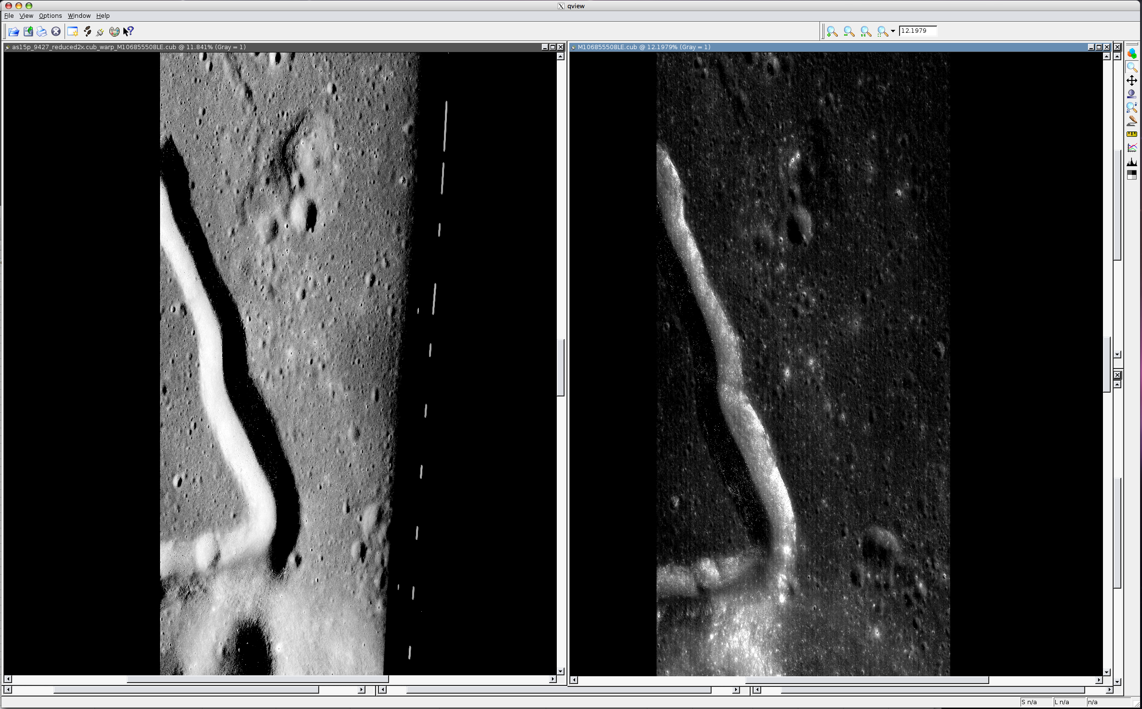
Similar Features
Images were correlated using prominent distinguishing features, computer determined overlap suggestions, and latitude and longitude values on index maps .
Apollo Image
LROC Image

Slide 9
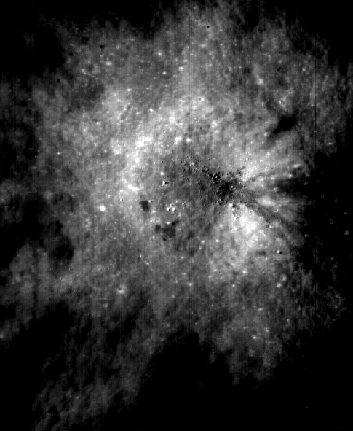
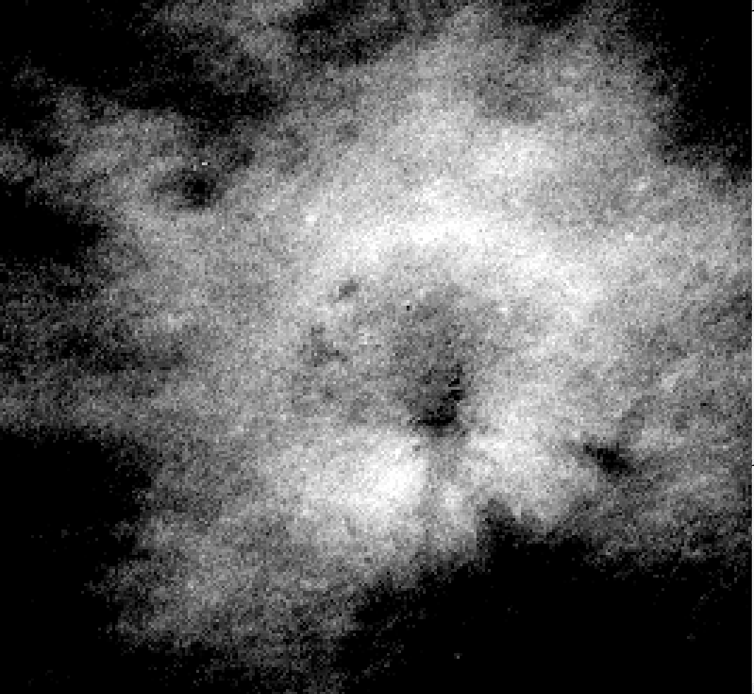
Resolution
The format of the
Apollo images was updated to match that of the LROC images.
Apollo Image
(1971-1972)
LROC Image
(2009)

Slide 10
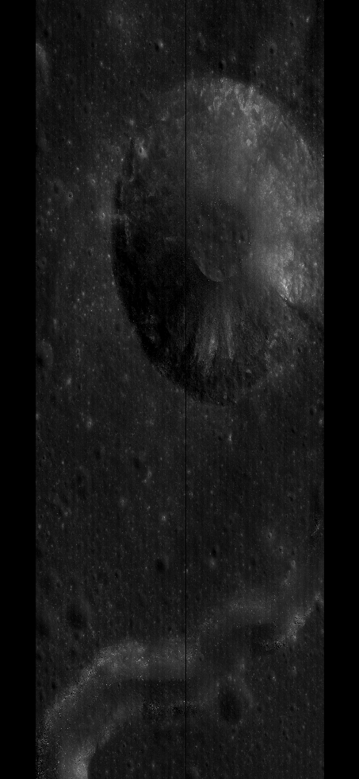
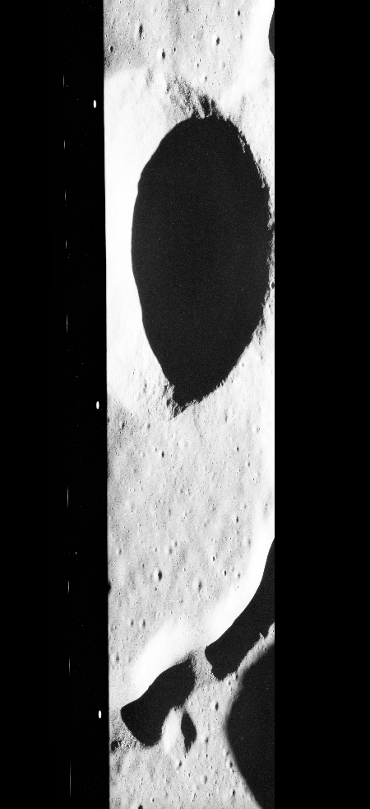
Differences
Similar features
100% Overlap
High Sun Angle
Apollo Image
(1971-1972)
LROC Image
(2009)

Slide 11

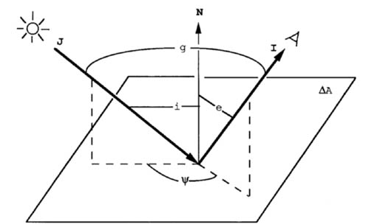
Angle of the Sun

Slide 12
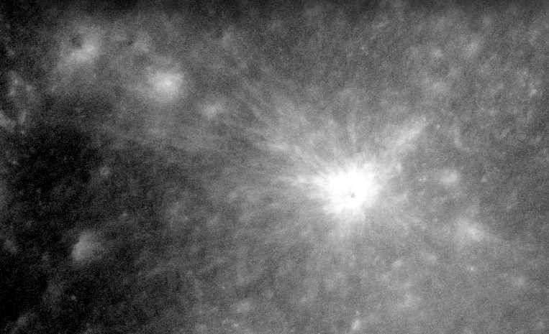
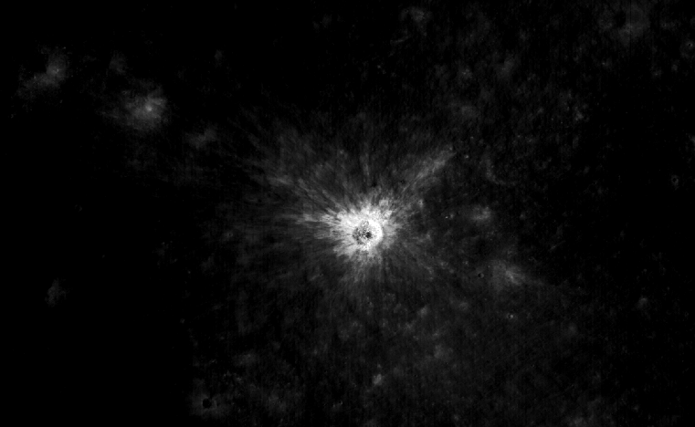
Bright Rays
Apollo Image (1971-1972)
LROC Image (2009)
Through a computer process known as blinking, two images were placed one on top of the other, and by flashing between the two images, the lunar surfaces were compared at once.

Slide 13
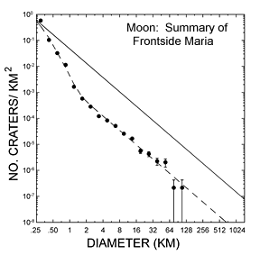
Neukum Production
Size Distribution Frequency on Moon
------- Lava Plains
_____Uplands
Date the surface

Slide 14
Results
Determine the number of craters
The findings show 0 new craters were discovered in the 7 analyzed images.
The area covered was approximately 1878.8 km², around 3.7x the area of Tucson
All craters observed were present during the time of Apollo and have been preserved for at least the last 40 years.

Slide 15
Discoveries
& Interpretations
There exit differences in lighting, dimension, and overlap of Apollo and LROC images.
0.0000495 % of the surface area of the moon was observed.
40 years in the history of the Solar System is a moment in time.

Slide 16



Thank You
Mentors:
Dr. Alfred S. McEwen
Mrs. Ingrid Daubar Spitale
Amber Keske Co-Investigator
Felicia Werchan Intern Advisor
UA NASA Space Grant Program & Personnel

Slide 17
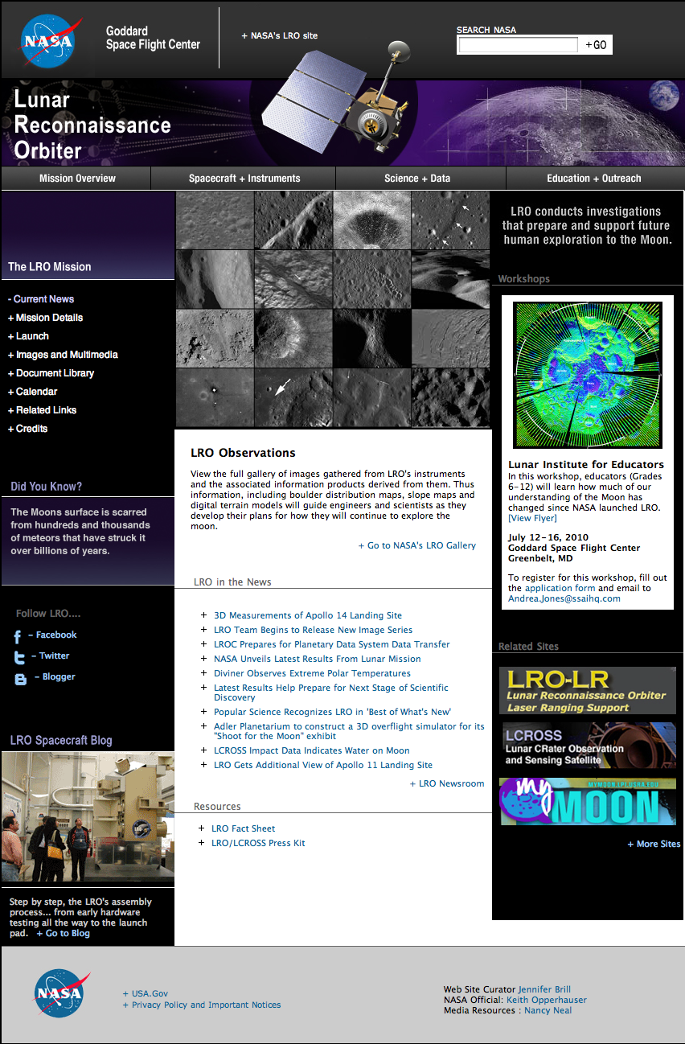
Public Website

